Slide 1
Built-in device for diagnosing FSM
Student: Hoha Maksym Valeriyovych .
Kharkiv 2018
Notes:
Dear Head!
Dear Members of the Examination Commission (EC)!
Your attention is given to the certification of the bachelor's degree on the topic: (----).
(Read the slide)

Slide 2
The purpose and objectives of the project
The purpose of attestation work is to develop an automatic machine model of the hardware system for the diagnosis of control devices in the electric power and gas supply, the presentation of this model in the languages of the description of the equipment and their implementation on the technological platform of the FPGA.
To achieve this goal, the following tasks need to be done:
Present the algorithm for managing the gas distribution point in the form of graph-scheme of the algorithm (AGS).
Based on the graph diagram of the algorithm, construct an automaton model of control device in the form of a graph of transitions of the machine and construct an algorithm for its diagnosis, bypassing all arcs of the graph of transitions.
Choose the technology platform for implementation of the control device.
Describe the algorithm for diagnosing the model in the language of hardware description and perform its verification.
Perform schematic implementation of control device and diagnostic device using CAD FPGA. Estimate hardware costs for the diagnostic system.
Notes:
At present, there are significant changes in the power industry related to the introduction of new automation and energy saving technologies.
At the level of enterprises and territories, automated control systems are used for technological processes, which mainly manage information flows.
In the power and gas supply systems, special local control and regulation systems are widely used, located in remote areas, for example, at transformer substations, gas distribution nodes, energy consumption points.
The lack of permanent transport links makes it impossible to monitor the functioning of these systems at all times.
The most common way of implementing such systems is to describe the CA, that is, the development of an automatic machine model.

Slide 3
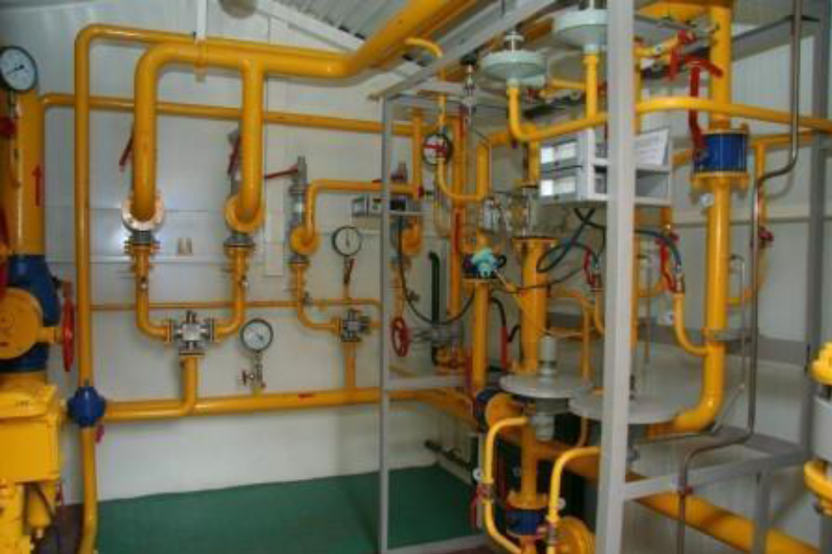
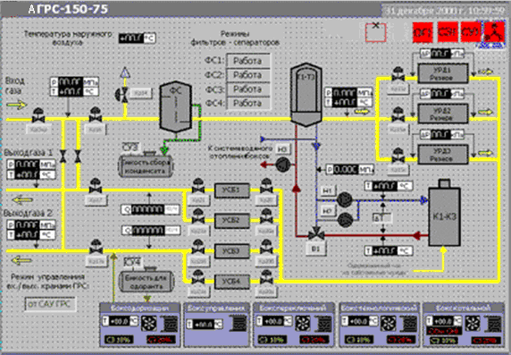
The object of management in a remote area
In electricity and gas supply, remote control points that operate without / or with minimal human participation, as well as without the use of personal computers, are quite common.
Control devices are implemented on the technological basis of MK, ASIC or FPGA.
The process of diagnosing a control device should go offline when you turn off control systems for a short time.
Notes:
As an object of management (OU) we consider an automatic gas distribution station (AGDS), which is usually located in a remote area without the presence of qualified personnel. Modern AGDS is a complex of equipment and measuring instruments for regulating gas distribution.
Regardless of the method of technical implementation, these systems implement the original control algorithm, described by the corresponding graph-scheme. In this case, there is a problem diagnosing the correct functioning of the control device without the use of indications of real sensors, because their inclusion in the diagnostic mode can disrupt the functioning of critical gas supply systems.
It is worth noting that this system is an open system of control (regulation system).

Slide 4
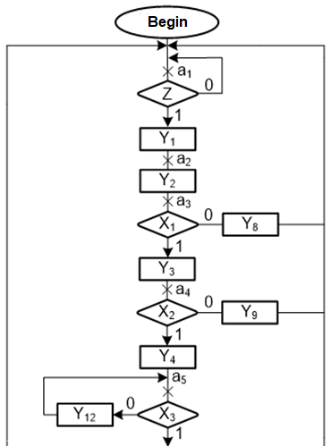
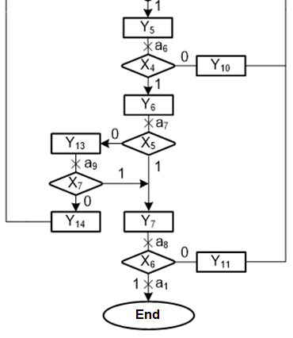
Algorithm of AGDS operation control system
Graphic diagram of the algorithm of AGDS
Notes:
An important task in the construction of automatic control systems is to ensure the reliability of their operation, which is impossible without the use of automatic systems of technical diagnostics.
In the design of modern systems of technical diagnosis, computer technology of automated design with the use of languages ​​of equipment description and modern technological base is widely used.
This approach will allow to realize the system of diagnosing a remote control point of any power system without the participation of a person and without disabling the main control system for a long time.

Slide 5
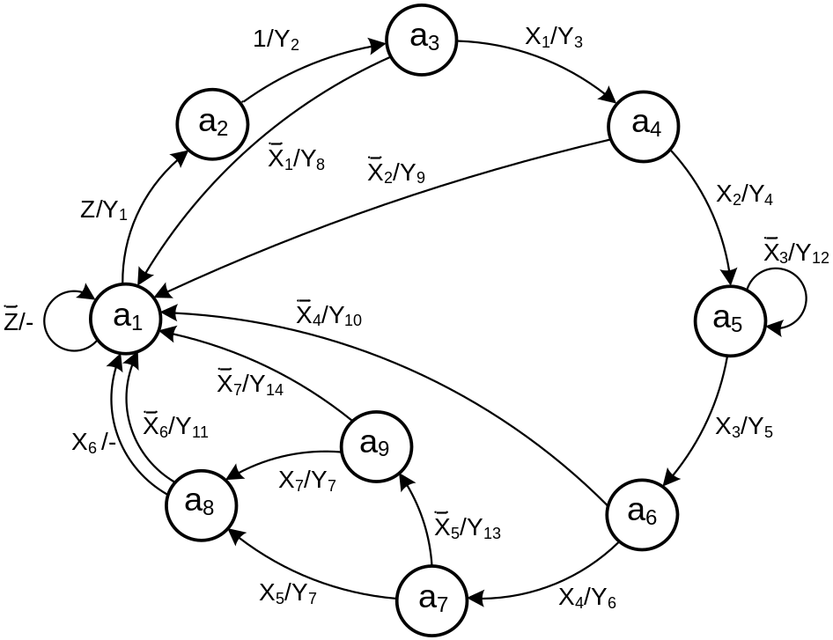
The model of control automaton in the AGDS control system
The transitions graph of the Mill control machine
A fragment of the VHDL-model of the AGDS control automaton
State_CurrentState: process (clk,reset)
begin
if rising_edge(clk) then
if reset='1' then State <= A1;
else State <= NextState;
end if;
end if;
end process;
State_NextState: process (X, State)
begin
Y<= (others=>'0');
case State is
-- X(0) is a bit that is marked on algorithm graph as Z
when "0001" =>
if (X(0)='1') then
NextState <= A2;
Y(1) <= '1';
elsif (X(0) = '1') then
NextState <= A1;
еlse NextState <= A1;
end if;
Notes:
To convert an AGS (algorithm graph scheme) into an automatic machine, it is necessary to note the state of the machine. As an automatic machine, we will consider Mill's machine. Its states on the AGS are denoted by the vertices entering the operator vertices. On the basis of Mill's automatic machine, the graph of transitions of the spacecraft is constructed.
The graph of transitions of the automaton is represented in the language of the description of VHDL equipment in the form of a two-process automaton template.

Slide 6
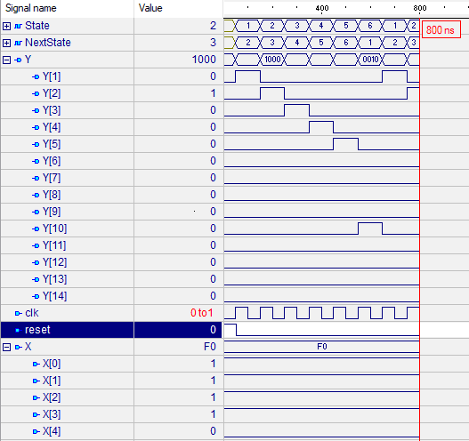
Modeling and synthesizing control automaton
Selected Device : 3s500efg320-5 | Варіант 1
Number of Slices | 10 out of 4656
Number of Slice Flip Flops | 9 out of 9312
Number of 4 input LUTs: | 18 out of 9312
Number of IOs | 24
Number of bonded IOBs: | 24 out of 232
Number of GCLKs | 1
Control automaton synthesis results
The operating mode shown on Waveform shows the operation of the control device, in the example of the sequence A1-A2-A3-A4-A5-A6-A1.
The transition from state to state is responsible for the initiation of blocks and sensors.
AGDS working Waveform
(control automaton)
Notes:
The slide demonstrates the simulation of a spacecraft on an example of the sequence of transitions A1-A2-A3-A4-A5-A6-A1 and the synthesis results (hardware costs).
The transition from state to state is responsible for the initiation of blocks and sensors. The device initiates and sensors are surveyed.
After a poll of each sensor it is a comparison of their indicators with the necessary for further work.
Positive test (X (1) = X (2) = X (3) = 1) shows that the values ​​do not exceed the permissible ones and the automaton continues to work correctly.
If the check does not pass (A6-A7; X (4) = 0), an emergency situation occurs (Y (10) = 1), which returns the machine to its original state (A1).

Slide 7
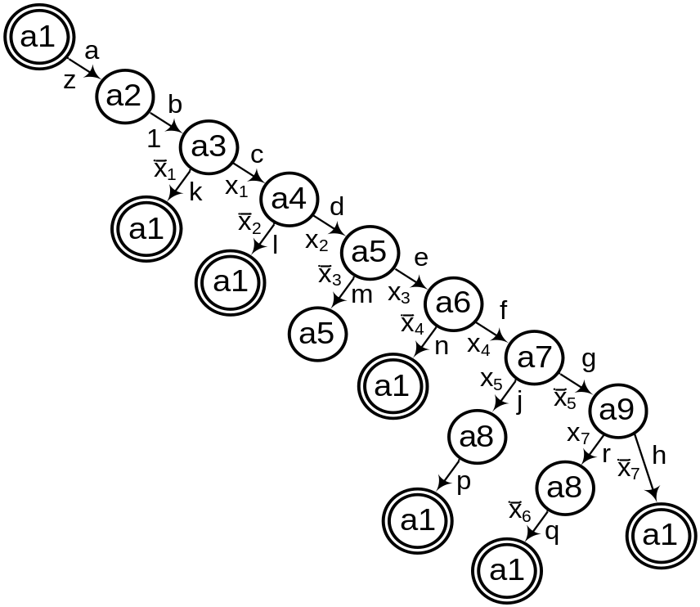
Diagnostic experiment bypassing the graph
Options for bypassing the graph of transitions of the CA
а1 – а2 – а3 – а1;
а1 – а2 – а3 – а4 – а1;
а1 – а2 – а3 – а4 – а5 – а6 – а1;
а1 – а2 – а3 – а4 – а5 – а6 – а7 – а8 – а1;
а1 – а2 – а3 – а4 – а5 – а6 – а7 – а9 – а1;
а1 – а2 – а3 – а4 – а5 – а6 – а7 – а9 – а8 – а1.
By the decision tree, alternatives for bypassing the arcs of the graph are constructed. It should be borne in mind that the so-called "non destructive DE" is carried out, when the bypass of the arcs of the graph begins with the initial vertex and it ends in it.
Tree of decision for the graph of transitions of the CA
Based on the strategy of bypassing all arcs of the CA graph, a diagnostic algorithm with guaranteed completeness for single transient failures (for example, transition a1 - a2 instead of a1 - a3), a binary decision tree is being constructed.
Notes:
Diagnostic experiment (DE) over the HDL-model of a finite automaton is to supply it with input influences, in accordance with the chosen strategy of bypassing the content graph of transitions, obtaining initial responses to Waveform and comparing the obtained reactions with the standard. On the basis of this, it is concluded that the HDL model is compliant.
Options forpassing the graph of transitions of the control automat (CA) are stored in the nonvolatile memory and used in conducting the DE with the use of a hardware diagnostic device.

Slide 8
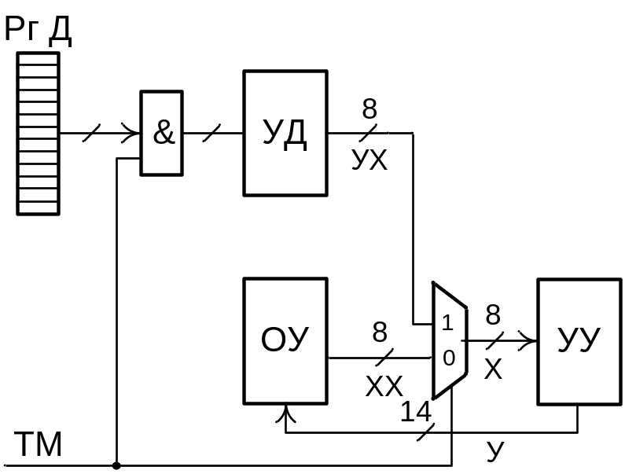
The structure of the diagnostic device
The block diagram of the control object with the diagnostic device is shown in the figure to the left, where:
УУ – CA – control automaton;
ОУ – CO – control object;
УД – DD – diagnostic device;
РгД – DR – data register, where the next option of bypassing the graph is entered;
У – Y – control signals;
XX – notification signals of the control object (in our case logically processed sensor indicators);
X – notification signals for the control device;
Diagnosis hardware device
УX – YX – "Simulation" of the warning signals by the diagnostic device;
ТМ (test mode) – operating mode of the device (TM = 0 - work in control mode, TM = 1 - work in diagnostic mode).
Notes:
When diagnosing the control device (CD) AGDS, working with sensors, measurement of physical quantities, there is a problem of implementation of the output values ​​(pressure, voltage, etc.) that arise in the real work of AGRS.
Proceeding from this, it is proposed to simulate the initial values ​​of the corresponding sensors in the binary alphabet {0, 1} (1 - the parameter is in the given allowable range of physical values, 0 - the parameter has exceeded the limits of the permissible values).
Read from the slide
Thus, the hardware implementation of the diagnostic device (DD) is proposed, which ensures the implementation of all transitions in the control automaton graph (CA), that is, actually implements its direct structural table.

Slide 9
Implementation of the diagnostic algorithm
state | Nextstate | X | УX(0-7)
a1 | a2 | Z=1 | 10000000
a2 | a3 | 1 | 00000000
a3 | a4 | Х1=1 | 01000000
 | a1 | Х1=0 | 00000000
a4 | a5 | Х2=1 | 00100000
 | a1 | Х2=0 | 00000000
a5 | a6 | Х3=1 | 00010000
 | a5 | Х3=0 | 00000000
a6 | a7 | Х4=1 | 00001000
 | a1 | Х4=0 | 00000000
a7 | a8 | Х5=1 | 00000100
 | a9 | Х5=0 | 00000000
a8 | a1 | Х6=0 | 00000000
 | a1 | Х6=1 | 00000010
a9 | a8 | Х7=1 | 00000001
 | a1 | Х7=0 | 00000000
Diagnostic algorithm. is realized with the help of the modified direct structural table of the control device (CD).
Schematic implementation of the CD can be carried out in several ways, depending on the method of encoding the incoming sequence of states of the automaton while traversing the graph of transitions.
Notes:
Read from the slide
It is worth noting that the main hardware costs go to the implementation of the data register and work with it (actually mimics the work of nonvolatile memory)
Read from the slide
"Let's consider several variants of coding bypassing the column of transitions"

Slide 10

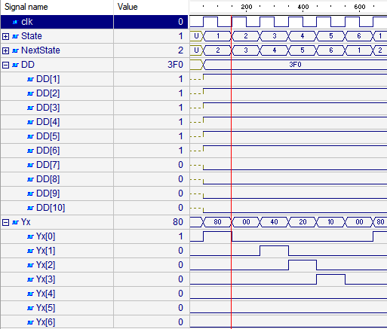
Bypass the transitions graph (bit encoding)
Schematic representation of the input array CD
An example of the input sequence of states a1 - a2 - a3 - a4 - a5 - a6 - a1.
A cheap way to implement a diagnostic algorithm in terms of equipment.
With this method of encoding a sequence of states of an automaton there are problems if the graph of transitions is a multigraph, that is, between a pair of vertices there is more than one arc, the transitions being determined by different signaling signals
Notes:
According to this variant, the sequence of states of the automaton is encoded in a bit array, each link of which corresponds to the state. If the bit is equal to 1, then the transition goes to the next state marked 1. The transition between the states is described as an ordinary two-process template. Zero in the link array corresponds to the return to the original state. The absence of bits "-" means that this link does not play any role, because there was a return to the initial state (A7 = 0).
Read from the slide

Slide 11

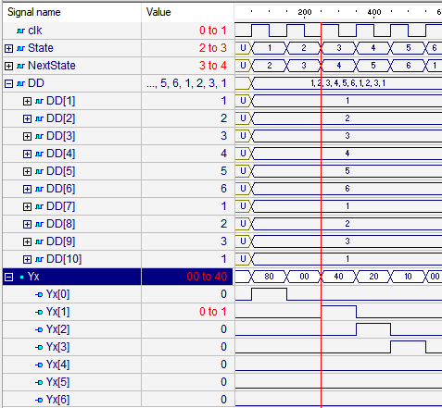
Bypass the transitions graph
(by the codes of the states of the automaton)
Schematic representation of the input array CD
An example of the input sequence of states a1 - a2 - a3 - a4 - a5 - a6 - a1.
Simplified perception of the algorithm, since each 4-digit number is a description of the state.
Transition between states is similar to the variant with bit coding.
The most cost effective way to implement the diagnostic algorithm
Notes:
According to this version there is a description of the CD, which takes an array of 4-bit numbers into the input, each of which is a description of the state. As soon as the vector of a further state equal to the initial ("0001") is found, then the sequence is considered complete and there is a return to the original state. If the detected sequence is not the end of the array, then the following are ignored.
Read from the slide.

Slide 12
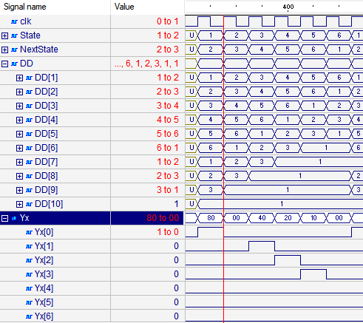
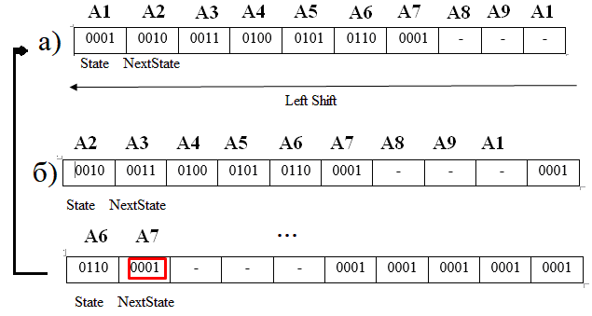
Bypass the transitions graph
(using the shift register)
Schematic representation of the input array CD
DD Waveform using the shift of the input sequence
The input array is copied to the data register, which actually represents the work with external nonvolatile memory.
Eliminates the disadvantage of the previous version of the implementation of the diagnostic algorithm in terms of the scalability of the diagnostic device in relation to the number of states of the automaton.
Notes:
This variant is a control device (CD) that accepts an array of 4-bit numbers, each of which is a state description. The first process is responsible for copying the input array into an intermediate and assigning the initial values ​​to the signals of the current (output - A1) and the subsequent states of the input array (in order to exclude the double assignment of the same values). After assigning signals to the initial values, with the front of the clock signal, there is a left shift to one element of the array and the assignment of the unit to avoid transitions that do not correspond to the sequence. If the next state is equal to the output (the initial one is A1), then the sequence is considered complete.
Read from the slide

Slide 13
Bypass graph conversion
(using the shift register) VHDL-model
CA VHDL-model fragment
--Process for initialization and switching DD array
State_CurrentState: process (clk,reset,DD)
begin
if rising_edge(clk) then
--ATTENTION! Reset (reset) must load
--only first sequence in ROM every time
if (reset='1') then
--Copying the first sequence from ROM to signal
DD <= c_Test_sequence;
-- Synchronize process must not working with signals
-- that operated in other process (State, NextState)
-- so NextState has a role DD(2)
-- Array item needs to be checked if it initial state or not
elsif(DD(2) = "0001") then
--Copying from ROM to signal
--ATTENTION!If we using all sequences there must be shifting
--an array of all sequences (another sequence except first)
DD <= c_Test_sequence;
else DD <= DD(2 to 10)&"0001";
end if;
--Initiation State and NextState after shifting
State <= DD(1); NextState <= DD(2);
end if;
end process;
Notes:
This slide reflects the fragment of the VHDL model of the control device (CD or CA) , or rather the synchroprocess.
Brief story of this fragment:
- Why so?
- What problems led to the formation of a fragment.
- How did it affect hardware costs?

Slide 14
Comparison of synthesis results
Selected Device : 3s500efg320-5 | Варіант 1
Number of Slices | 10 out of 4656
Number of Slice Flip Flops | 9 out of 9312
Number of 4 input LUTs: | 18 out of 9312
Number of IOs | 24
Number of bonded IOBs: | 24 out of 232
Number of GCLKs | 1
Selected Device : 3s500efg320-5 | Варіант 1 | Варіант 2 | Варіант 3
Number of Slices | 13 out of 4656 | 27 out of 4656 | 23 out of 4656
Number of Slice Flip Flops | 16 out of 9312 | 16 out of 9312 | 35 out of 9312
Number of 4 input LUTs: | 15 out of 9312 | 21 out of 9312 | 17 out of 9312
Number of IOs | 20 | 50 | 10
Number of bonded IOBs: | 17 out of 232 | 39 out of 232 | 10
IOB Flip Flops: | 7 | 28 | 10
Number of GCLKs | 1 | 1 | 1
Control automaton and the diagnostic machine synthesis results comparison
Notes:
The slide presents a comparison of the synthesis results of the control automaton AGDS and the diagnostic machine. It should be noted that these hardware costs are comparable.
Analysis of the synthesis results of various variants of circuit implementations of the DD showed the following:
1. Hardware costs for the implementation of DDs in the first option are minimal, but with this method of encoding the sequence of states of the automaton there are problems if the graph of transitions is a multigraph, that is, between a pair of vertices there is more than one arc, which transitions are determined by different signaling signals (for the considered automaton it pair of states a8-a1).
2. In the scheme implementation of the DD option 3 there are approximately 2 times more sliders (Slice Flip Flops) than in other embodiments. This is due to the fact that in this option, the input c_Test_sequence array is copied to the DD register, which actually simulates the work with external nonvolatile memory.
3. From the point of view of the scalability of the DD for the number of machine states, the third variant of the circuit implementation is preferable, since with the increase in the length of the sequence to bypass the machine graph, the hardware costs in this variant grow in a small amount, which can not be said about option 2.
4. The hardware costs of the PD with the first-best chance of the implementation of the scheme can be compared with the hardware costs of the CD, which confirms the correctness of the chosen method of constructing a hardware diagnostic device.

Slide 15
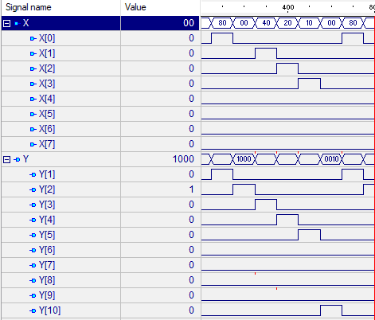
General model of control device and diagnostic device
--Declare libraries and entity of structure model
…
--Declare components
…
--Entry to component binding
signal Yx:STD_LOGIC_VECTOR(0 to 7);
begin
UUT0:GAS_Diagnostic_Device
port map(clk=>clk,reset=>reset,Yx=>Yx);
UUT2:GAS_FSM
port map(clk=>clk,reset=>reset,X=>Yx,Y=>Y);
end Workstation;
Complete Waveform with the implementation of the diagnostic algorithm
CA and DD structural model description
Notes:
The connection between the control device CD and the DD is a specific control and diagnostic system of the device or even a separate system. The CA can operate separately from the DD, by controlling the operation of the system or device, in the form of supplying output signals that initiate the execution of operations. Using a complete control and diagnostic system is a test mode for verifying the behavior of a device or system.

Slide 16
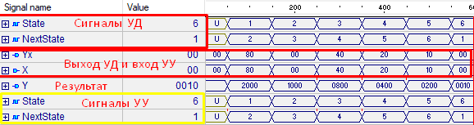
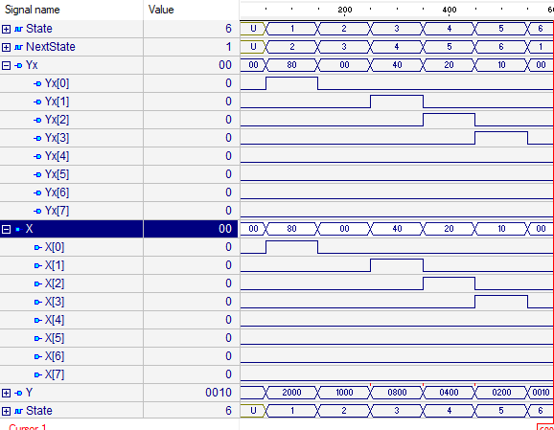
The result of the simulation and synthesis of the diagnostic device
Option to bypass the sequence
a1 - a2 - a3 - a4 - a5 - a6 - a1
Selected Device : 3s500efg320-5 | Варіант 1
Number of Slices | 34 out of 4656
Number of Slice Flip Flops | 44 out of 9312
Number of 4 input LUTs: | 38 out of 9312
Number of IOs | 16
Number of bonded IOBs: | 17 out of 232
Number used as Shift registers: 1 | 1
Number of GCLKs | 1
Notes:
This slide reflects the result of simulating the device for diagnosing and synthesizing this device. The simulation of the operation of the PD for the option of bypassing the sequence a1 - a2 - a3 - a4 - a5 - a6 - a1.
The constructed VHDL models of the control and diagnostic automata must be verified by the tools of the Active-HDL simulation system. Verification results are analyzed by a waveform, in which the law of functioning of the indicated automata is visually displayed. The result of the simulation of the work of the PD on the implementation of the option of bypassing the graph a1 - a2 - a3 - a4 - a5 - a6 - a1 is presented. Also, the total hardware costs for the synthesis of the CD and DD model by means of the XILINX ISE CAD in the Spartan 3E FPGA are shown in the table.

Slide 17
Conclusions
This work demonstrates the possibilities of using modern FPGA CAD when designing digital control and diagnostics systems in electric power and gas supply.
The analysis of the schematic realization (synthesis) of the HDL models of the control device (control automaton - CA) and the hardware of the diagnostics (diagnostic machine - the diagnostic device - DD) allows to estimate the value of additional equipment costs by using the Quay criterion.
The analysis of additional expenses of the equipment showed that they can be compared with the hardware costs of the control device itself. On the one hand, this increases the hardware costs of the digital control system as a whole, but, on the other hand, when implementing the control system on the FPGA, the crystal, as a rule, is present unprogrammed programmable logic that can be used under the diagnostic hardware.
If to say about reduction of additional expenses of equipment on the device of diagnostics, then in the automated design of digital control systems should be used methods of standard design and built-in diagnostics.
Notes:
Thank you for your attention, dear commissions!
Suggest a brief discussion ("If you have any questions, I will gladly answer them").

